Slide 1
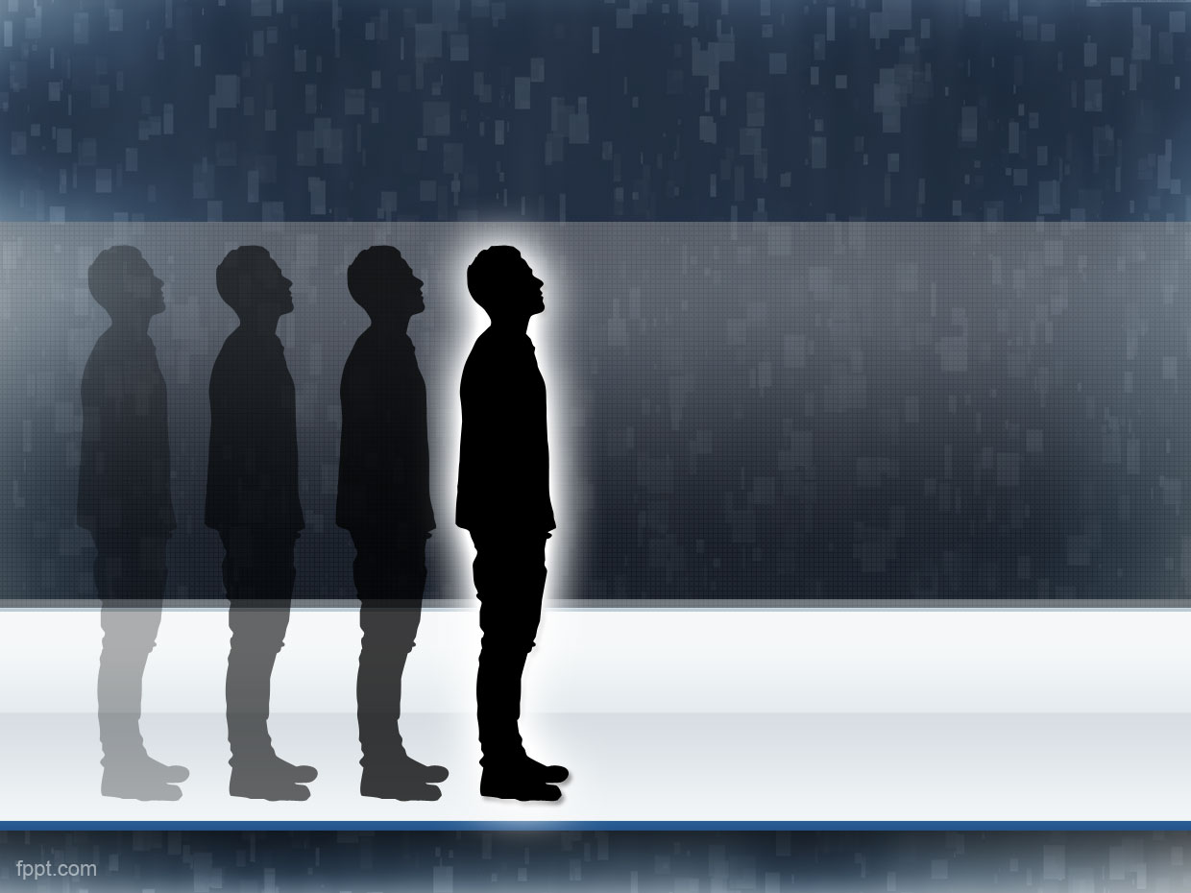
People detection
A Project by: Chiara Bizzotto,
Maurizio Ingrassia e Roberta Papa

Slide 2
Scope & Target
Detect people in a scene
Each person must be found at least once in a set of frames
possible applications
in a videosurveillance system

Slide 3
Constraints
Limited to pedestrians
Good performances only in enviroments with few people
Fixed camera
(For now) works only at one scale

Slide 4






Gantt
Project presentation
Project assignment
6/16/2015
7/14/2015
Day 1
5
9
13
17
21
25
29
2015
Today
6/14/2015
Problem analisys
6/23/2015
6/18/2015
Research
7/13/2015
6/24/2015
Software development
7/12/2015
7/6/2015
Labeling
7/12/2015
Parameters tuning
7/11/2015
7/14/2015

Slide 5
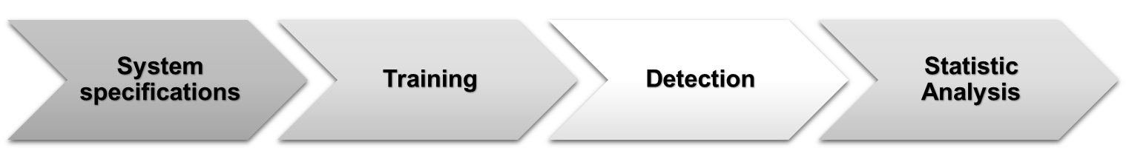
Software
THE PROJECT

Slide 6
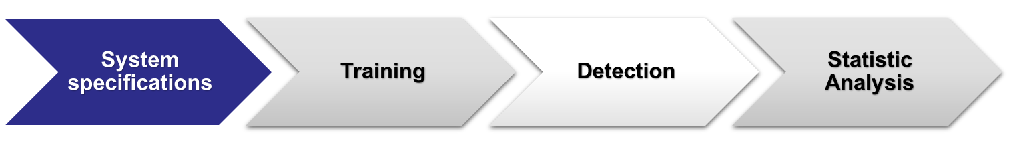
Software
Features vector: HOG
    8 orientations
    16x16 Pixel per cell
    1x1 Cells per block
Classifier: SVM
    Linear Kernel
    Faster Prediction on probability
Indipendence to features and classifier

Slide 7
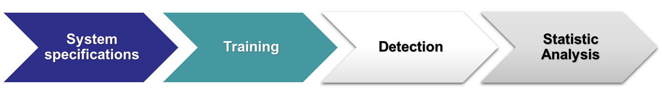
Software
Dataset :
    ViPeR for positive examples
    Custom set for negative examples
    Window pixels size 48x128
    Total set of ~6000 images

Slide 8
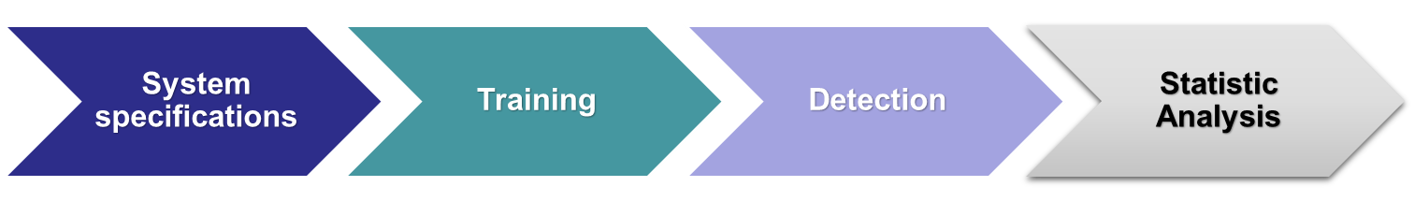
Software
Background subtraction: obtains a binary mask that highlights only the movement
Detection: sliding window over the frame (dimension = 48x128)
Non Maxima Suppression on the probability associated with each rectangle

Slide 9






Software
Frame
Sliding window
Detection
NMS
Background subtraction
Mask
Number of persons found

Slide 10
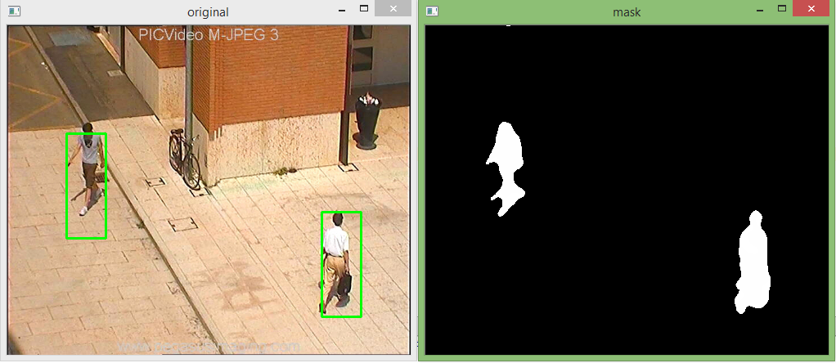
Software
Detection
Mask

Slide 11
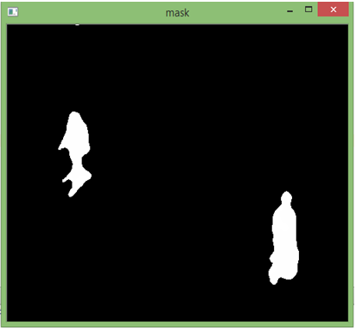
Software
Sliding window will check only the range between the two frames for a faster analysis

Slide 12
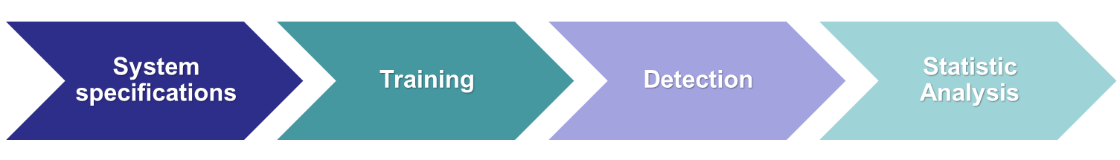
Software
Cross-comparison between groundtruth and people found by our system
      Accuracy
      Precision
      Recall
      F1-score
Mediated on a validation set

Slide 13
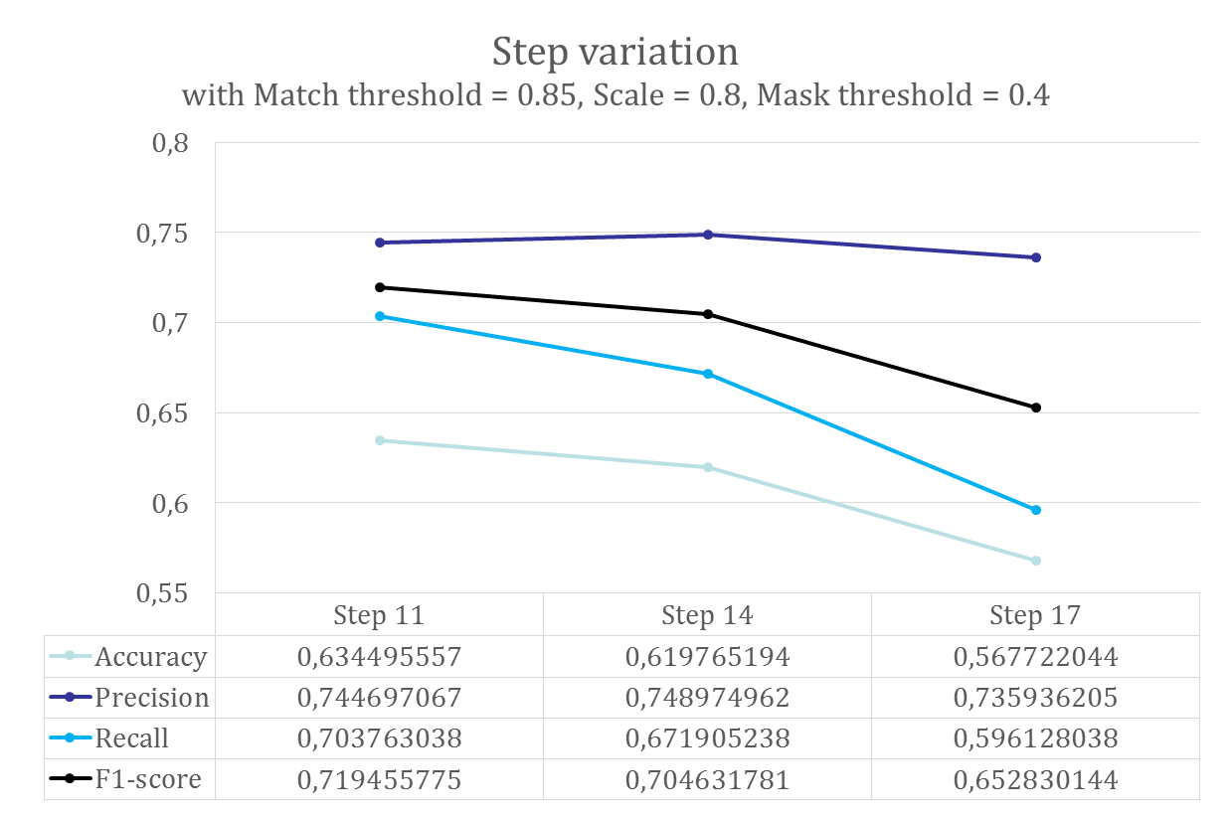
Results

Slide 14
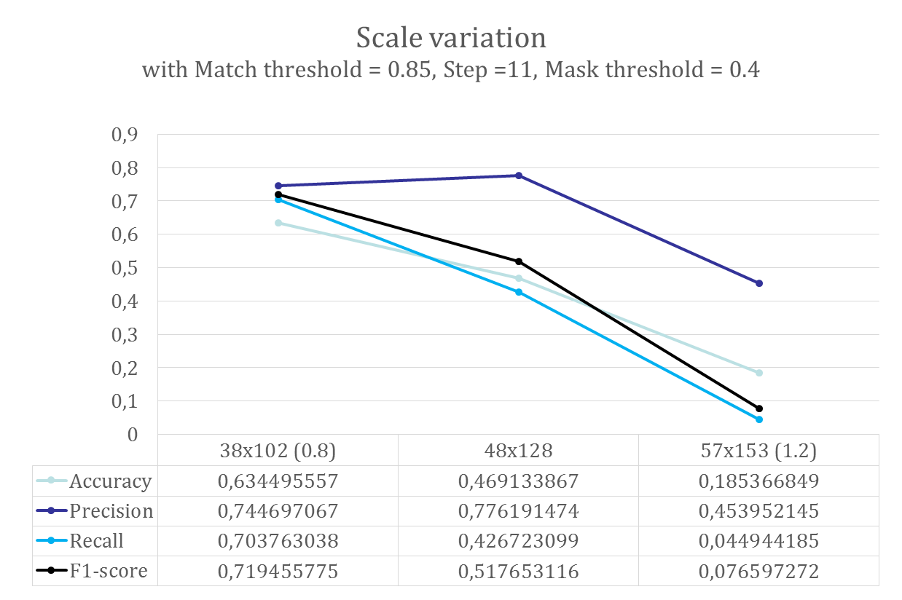
Results

Slide 15
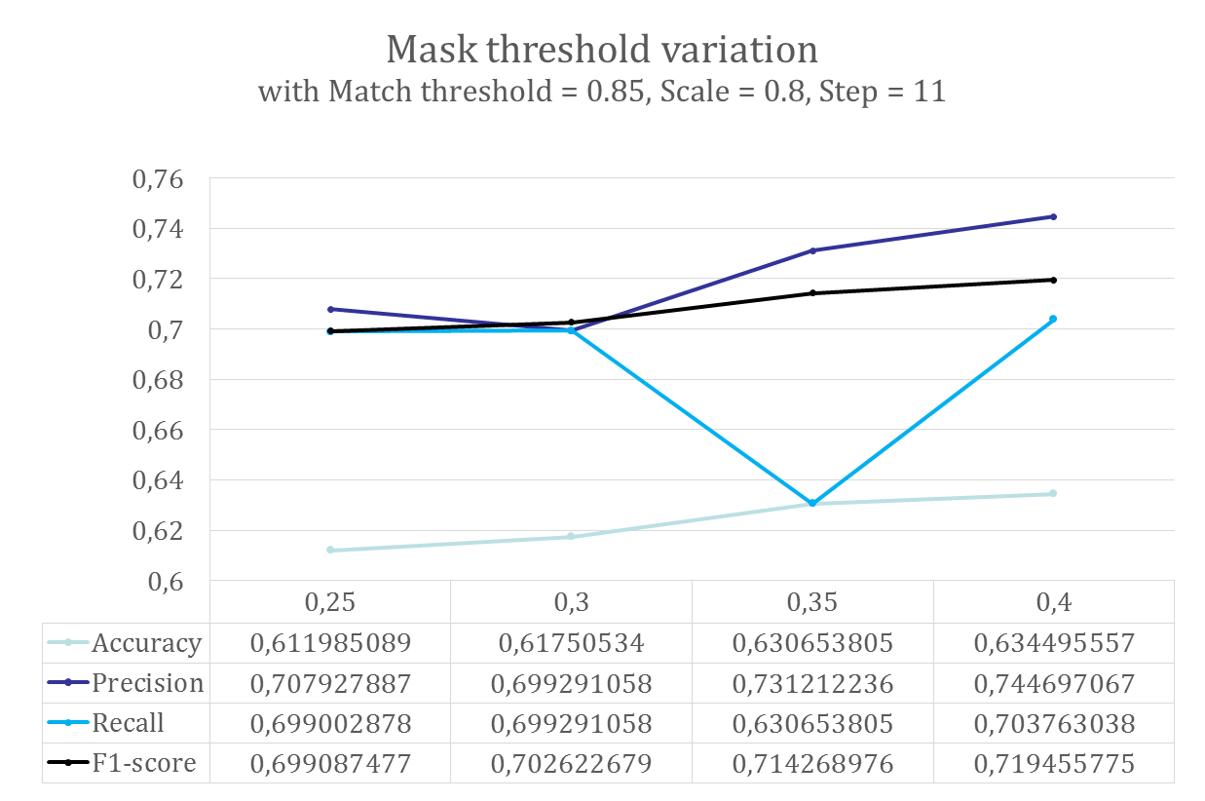
Results

Slide 16
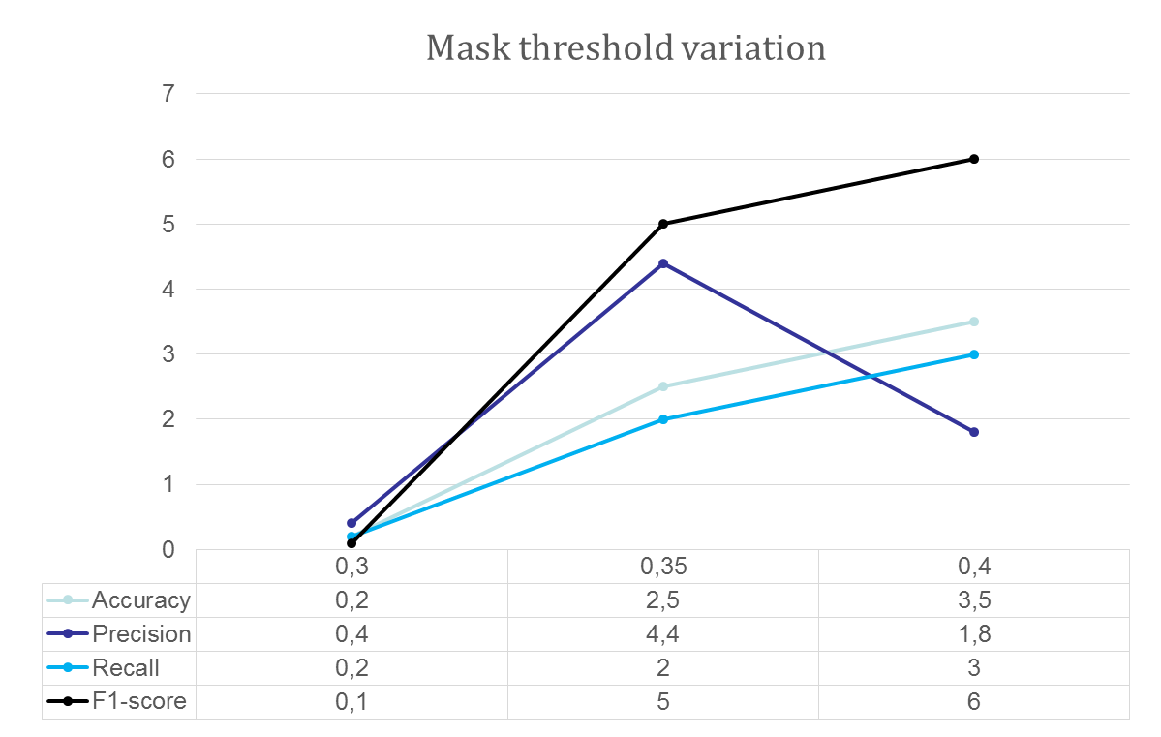
Results

Slide 17
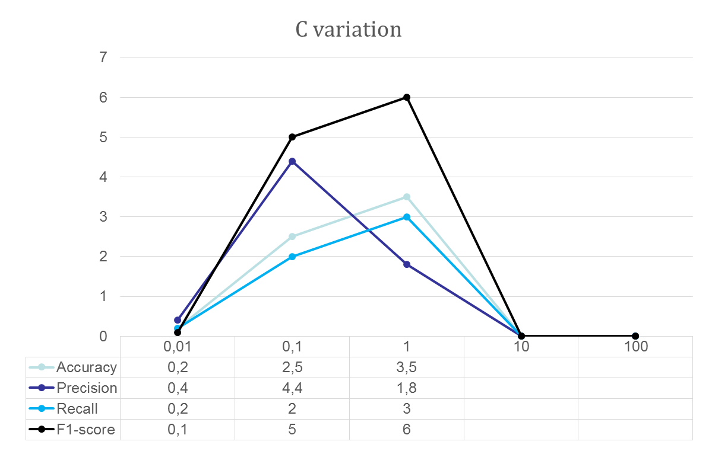
Results

Slide 18
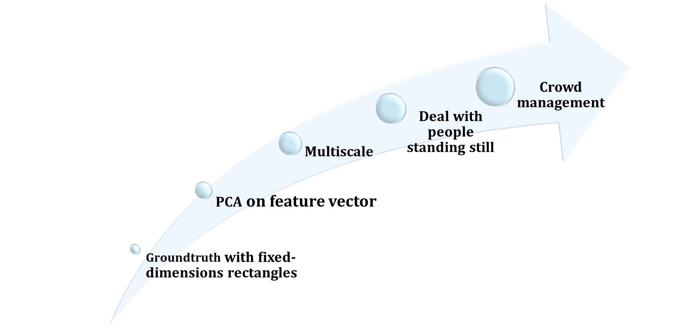
Future work

